Slide 1
CYBERSECURITY AGENCY
Here’s where your presentation begins

Slide 2
Mövzu:Təhlükəsizlik hədələrinə qarşı tədbirlər

Slide 3
TABLE OF CONTENTS
ABOUT US
OUR SERVICES
01
02
OUR CLIENTS
OUR TEAM
03
04
Here you could describe the topic of this section
Here you could describe the topic of this section
Here you could describe the topic of this section
Here you could describe the topic of this section

Slide 4
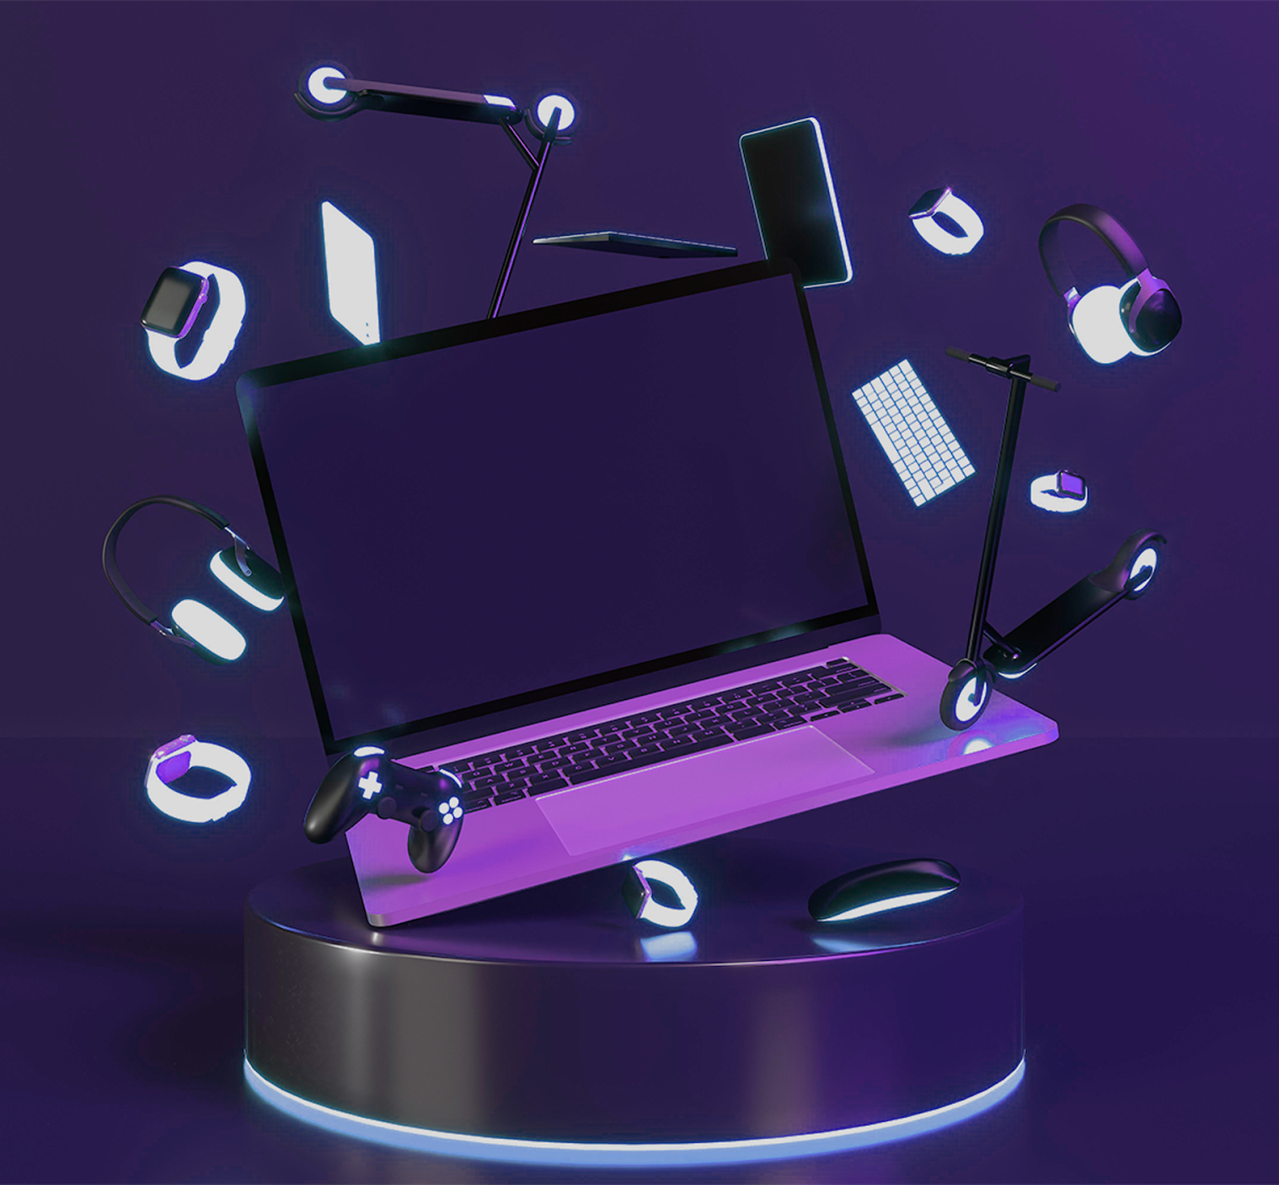

ABOUT US
This could be the part of the presentation where you can introduce your company or agency. Keep it short and go straight to the point. Your audience will appreciate that

Slide 5
OUR EVOLUTION
2017
2018
2019
2020
MERCURY
VENUS
MARS
JUPITER
Mercury is the closest planet to the Sun
Venus is a planet with a beautiful name
Despite being red, Mars is a cold place
Jupiter is a gas giant and the biggest one

Slide 6

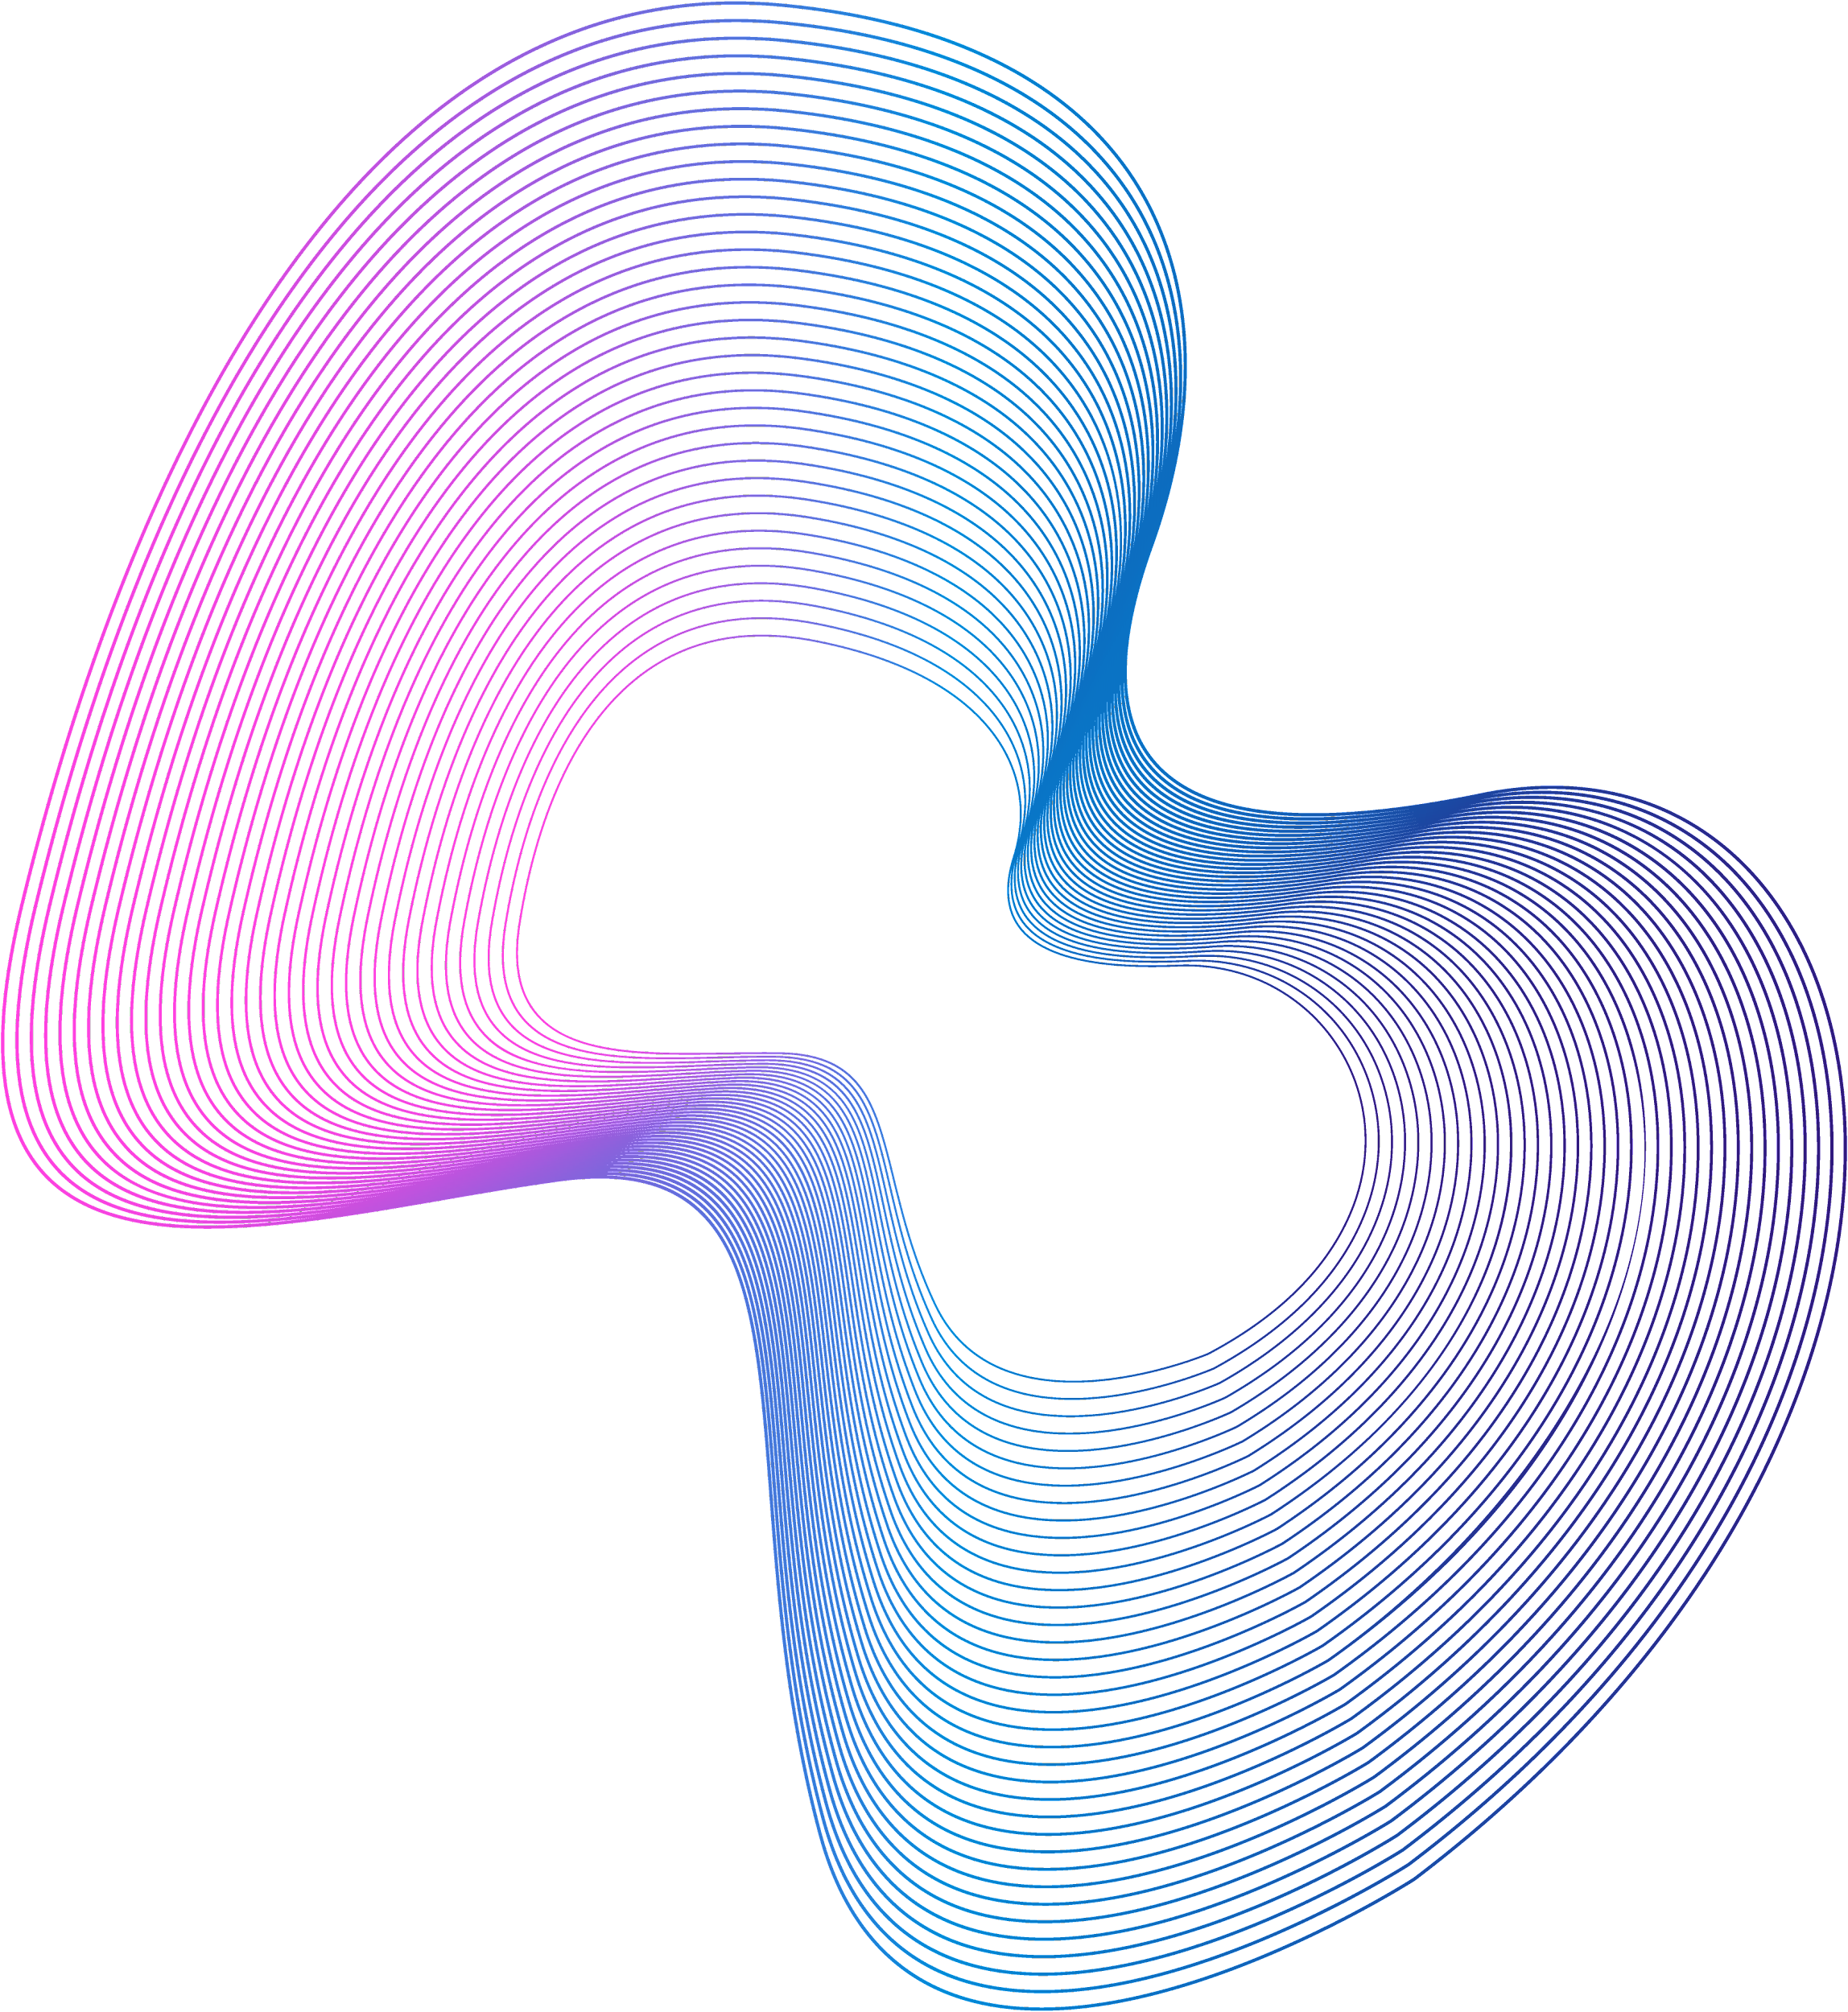
WHAT SETS US APART?
JUPITER
VENUS
MARS
It’s a gas giant and the biggest planet in the Solar System
Venus has a beautiful name and
is the second planet
Despite being red, Mars is actually a cold place

Slide 7
AWESOME WORDS

Slide 8
WHAT DO WE DO?
MERCURY | Mercury is the smallest planet of them all | Mercury is the smallest planet of them all
MARS | Despite being red, Mars is a cold place | Despite being red, Mars is a cold place
JUPITER | Jupiter is the biggest planet of them all | Jupiter is the biggest planet of them all
VENUS | Venus is the second planet from the Sun | Venus is the second planet from the Sun

Slide 9
HOW DO WE DO IT?
DYNAMIC
INTERACTIVE
STATIC
AUDIOVISUAL
Mercury is the closest planet to the Sun
Despite being red, Mars is a cold place
Venus has a beautiful name and is very hot
Saturn is composed of hydrogen and helium

Slide 10

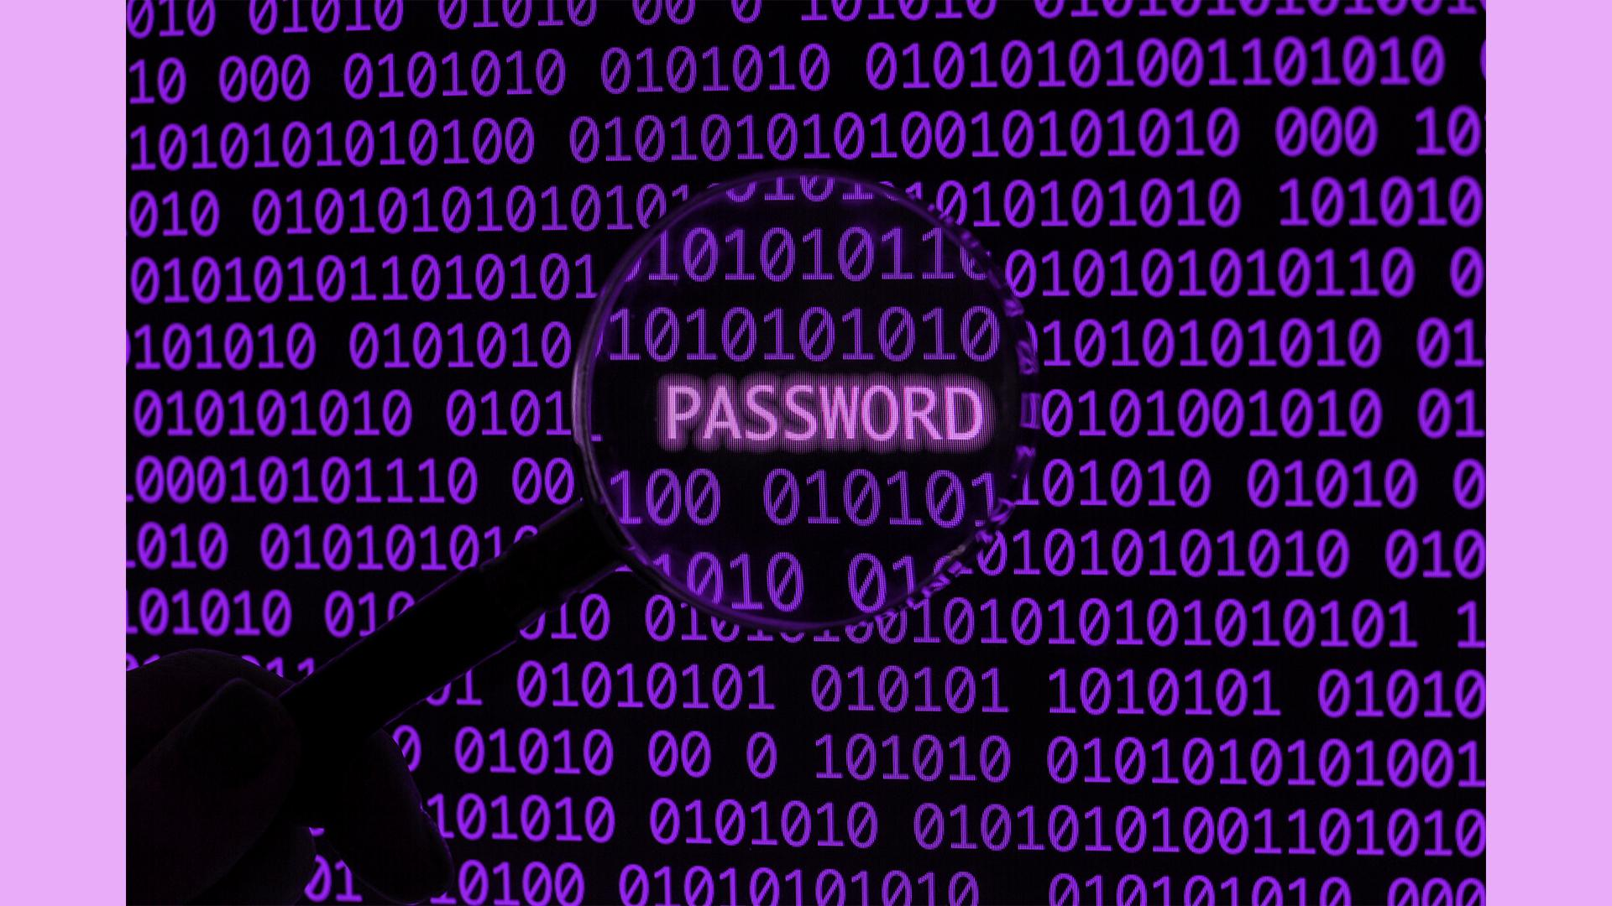
WHAT DO WE OFFER?
You can replace the image on the screens with your own work. Just delete these ones and add yours:
Device Support: Computer, Tablet, Laptop, Phones…
Key Recovery
Safe Investment

Slide 11
1,004,008
Big numbers catch your audience’s attention

Slide 12
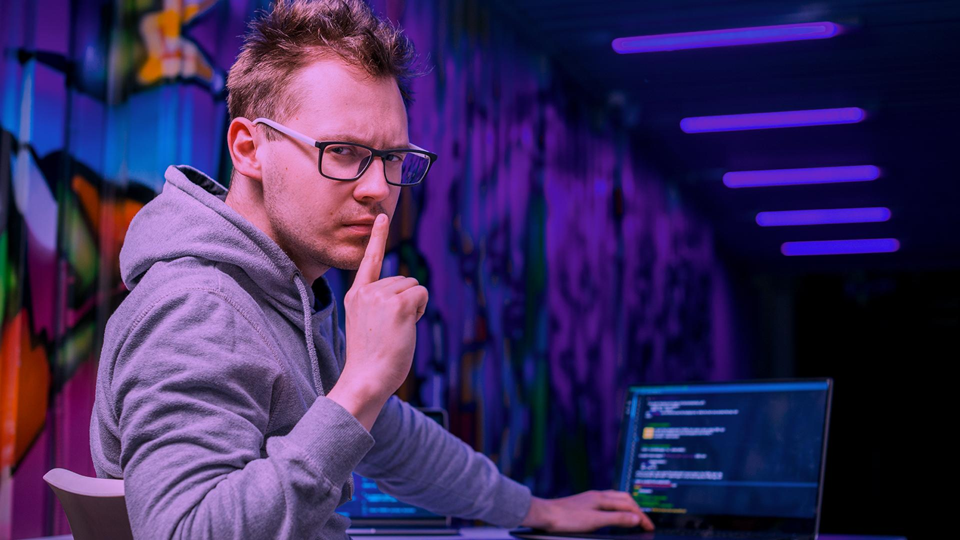
A PICTURE IS WORTH A THOUSAND WORDS

Slide 13
03
OUR CLIENTS
You could enter a subtitle here if you need it

Slide 14
OUR CLIENTS AROUND THE WORLD
< 1M
> 1M
Find out where all our clients around the world are located:
Mars is actually a cold place
Venus has a beautiful name

Slide 15
WHAT DO THEY SAY?
—CYBERSECURITY CLIENT
“This is a quote, words full of wisdom that someone important said and can make the reader get inspired.”

Slide 16
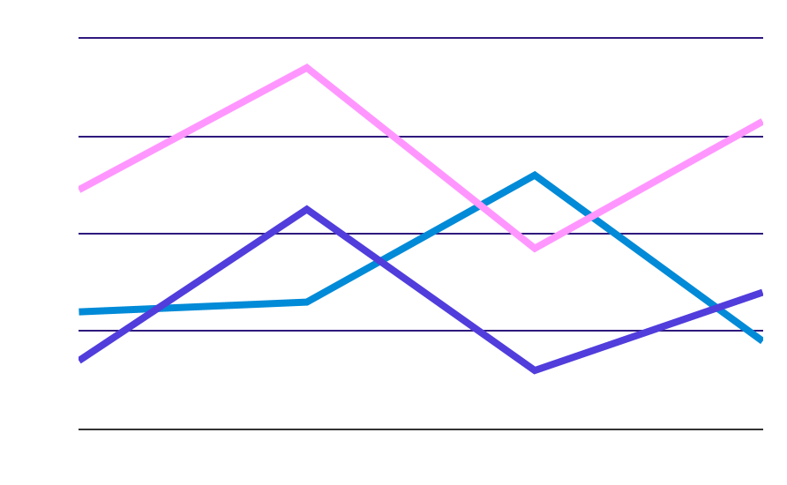
OUR STATISTICS
MARS
VENUS
SATURN
Expected income
New employees
New displays
To modify this graph, click on it, follow the link, change the data and paste the new graph here, replacing this one

Slide 17
CASE STUDIES
MERCURY
JUPITER
It’s the smallest planet
It’s the biggest planet
SATURN
MARS
It has several rings
It’s a cold place
VENUS
NEPTUNE
It has a beautiful name
It’s the farthest planet

Slide 18
333,000.00
24h 37m 23s
386,000 km
earths is the Sun’s mass
is Jupiter’s rotation period
distance between Earth and the Moon

Slide 19
OUR AWARDS
MERCURY
MARS
VENUS
JUPITER
SATURN
NEPTUNE
Mercury is the closest planet to the Sun
Despite being red, Mars is a cold place
Venus has a beautiful name and it’s very hot
It’s a gas giant and the biggest planet
Saturn is the ringed planet and a gas giant
It’s the farthest planet from the Sun

Slide 20
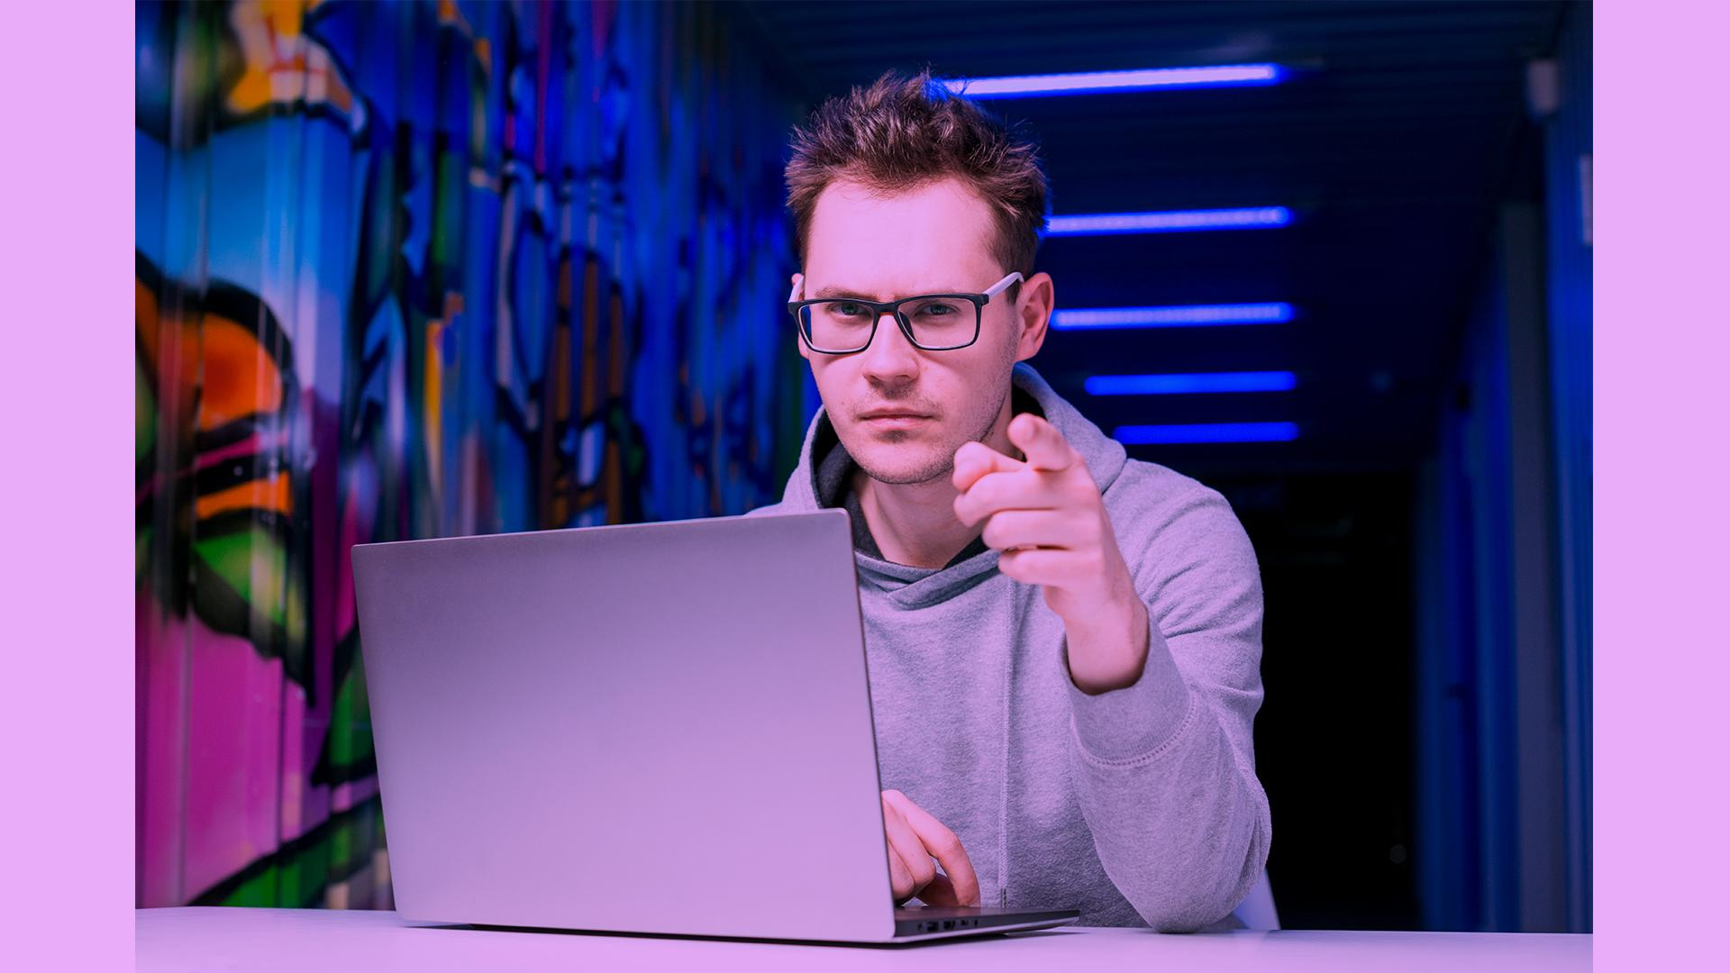
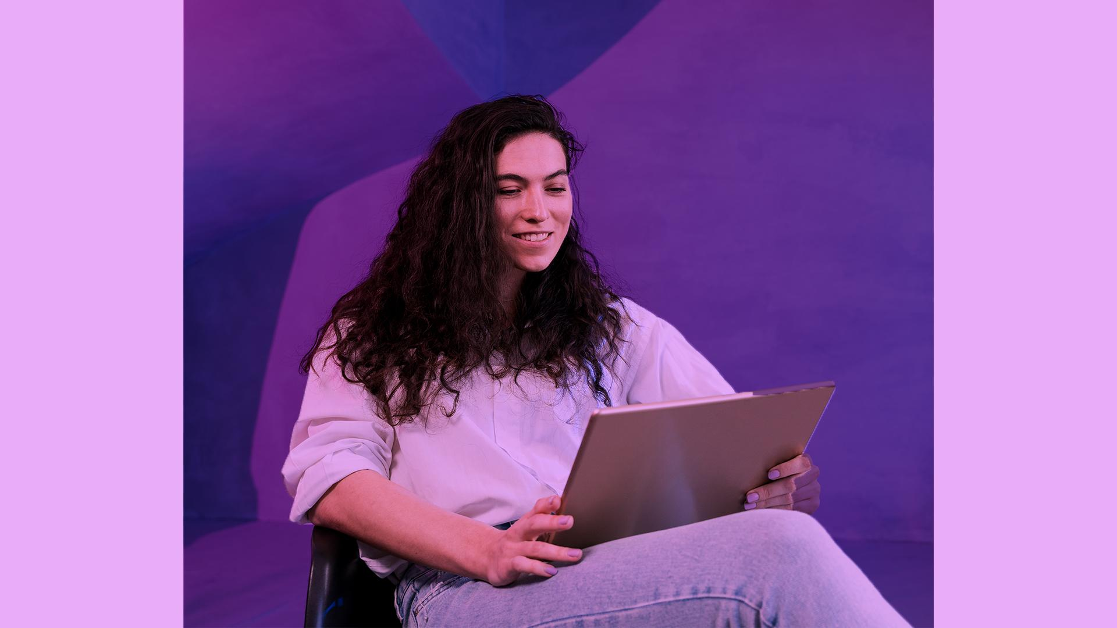
MEET THE TEAM
ALICE SMITH, 24
JOHN CARTER, 35
You can replace the mage on the screen with your own
You can replace the mage on the screen with your own

Slide 21
CONNECT WITH US
Do you have any questions?
addyouremail@freepik.com
+91 620 421 838
yourcompany.com
Please keep this slide for attribution

